Slide 1

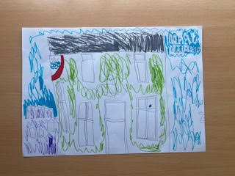
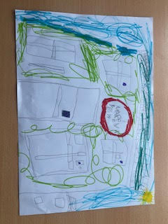
Standards & Quality Report
2025–2026
Marina View Nursery
Children’s artwork by
Neave McClure & Amber Goslan
Nurture
•
Discover
•
Inspire

Slide 2
Introduction
Our shared vision
Our team
We have a dedicated staff team of 16 Early Years Practitioners, 2 Senior Early Years Practitioners, 2 Modern Apprentices, 1 Business and Catering Manager, 1 Nursery Manager and 1 full-time Cook who provides fresh, nutritious home cooking.
At Marina View Nursery our shared vision is to provide a nurturing, caring environment which supports children’s natural curiosity and encourages them to become confident and independent learners.
Our environment
Purpose of this report
We provide a warm and welcoming environment for children and families. Staff and management are committed to supporting all children to feel safe, secure and reach their full potential.
This Standards and Quality Report reflects on the successes of the previous year’s work and our success in meeting the priorities set out in the centre’s Improvement Plan.

Slide 3
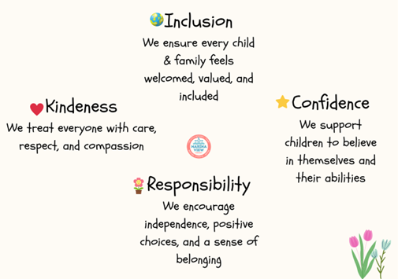
Our Vision, Values & Aim
Our Vision
We strive to provide a high-quality service where children experience a caring, nurturing environment that inspires them to learn through their natural curiosity.
Our Aim
Our aim is to support and encourage children to reach their full potential in an inclusive, respectful, and nurturing environment. We are committed to providing a high-quality service where children feel cared for and are inspired to learn through their natural curiosity.
Our values were updated in consultation with parents and staff.

Slide 4
Context of Marina View Nursery
Our setting
Our playrooms
Marina View Nursery is located in the Templehill area of Troon, within a short walking distance of the town centre and at the heart of a busy local community. The town and surrounding locality have a population of approximately 19,000, with around 28% aged 65 and over.
Marina View Nursery opened in August 2016 following extensive renovation. We are registered with the Care Inspectorate to provide childcare and education for up to 93 children aged from 6 weeks to 5 years. Our registration is flexible, enabling children to move between playrooms when developmentally ready.
The Cove — 6 weeks to 2 years
The Lighthouse — 2 to 3 years
The Beach Hut — 3 to 5 years
Sleep rooms are available within The Cove and adjacent to The Lighthouse. Children are always supported by staff during sleep periods.
Reception and kitchen are on the ground floor, with staff areas and storage on the upper floors and a large storeroom in the basement.
Open 50 weeks per year • Monday–Friday 8.00am–6.00pm • Breakfast club from 7.30am

Slide 5
Our Community
Staffing
Local context
Our staff team consists of 1 Nursery Manager, 1 Business and Catering Manager, 2 Senior Early Years Practitioners, 16 Early Years Practitioners, 3 Supply Early Years Practitioners, 2 Modern Apprentices and 1 Cook. Cleaning is carried out by an external contractor.
Troon is generally considered an affluent area within South Ayrshire. A significant proportion of the working population are employed in professional, administrative or skilled roles, and many families are in full-time employment. However, approximately 1 in 10 children live in poverty, highlighting a range of socio-economic circumstances within our community.
Scottish Index of Multiple Deprivation (SIMD)
Our children come from Decile 1 through to Decile 10 within the Scottish Index of Multiple Deprivation.
The original report includes a link to SIMD information.

Slide 6
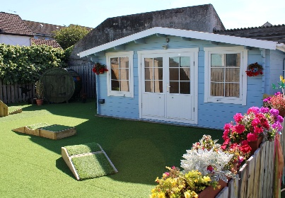
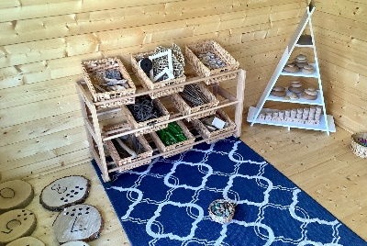
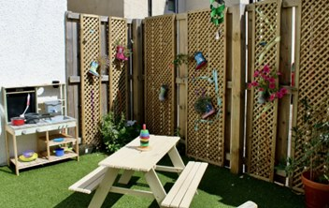
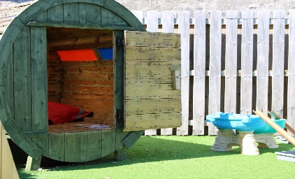
Outdoors
Our outdoor spaces are used every day to support challenge, independence, physical development and safe risk-taking.
The main secure outdoor learning environment is used daily by Lighthouse and Beach Hut children, with a separate secure space for Cove children. Resources include tunnels, den-building kits, ramps, a climbing frame and wheeled toys such as bicycles.
Two staff members completed outdoor numeracy and literacy training through Learning through Landscapes, strengthening our approach to outdoor learning. A smaller outdoor area beside the Lighthouse Room includes a growing area and carefully selected resources, extending indoor learning opportunities.

Slide 7
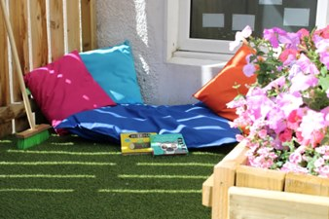
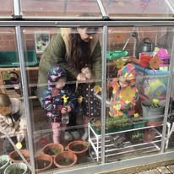
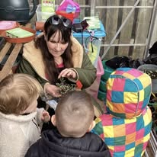
Growing, Exploring & Learning Outdoors
Our greenhouse
Children benefit from regular access to our greenhouse, where they have been actively involved in planting and growing their own flowers, fruit and vegetables, supported by Jen from Neon Skies. This has provided meaningful opportunities to learn about nature, develop responsibility and make connections with where food comes from.

Slide 8
Partnership, Learning & Transitions
Partnership & professional learning
Learning Journals & communication
In August 2018, we entered partnership with South Ayrshire Council to provide funded places for eligible children, including eligible two-year-olds and children allocated a place under Request for Assistance criteria.
Staff access South Ayrshire CLCP, in-house, online and external training. Regular team meetings support new initiatives, practice development, procedural changes and ongoing professional learning.
We use the Learning Journal app to record and share children’s learning. Daily observations link to each playroom curriculum. Stories, daily diaries, events and key messages are shared with families, alongside detailed verbal handovers to support strong home–nursery partnerships.
Transitions
Transitions are tailored to each child and supported by strong two-way communication. New children begin with short visits alongside a parent, gradually increasing in length. Moves between playrooms are supported through gradual visits with the child’s keyworker as confidence grows.

Slide 9
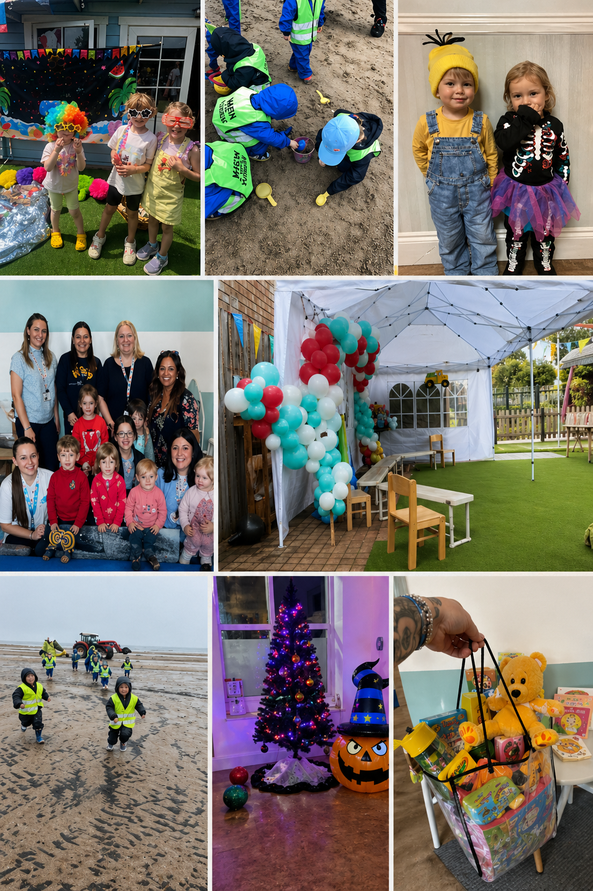
A Busy Year at Marina View
Highlights included our first Summer Fete and Graduation event; Beach School was rebranded as Beach Explorers; seasonal celebrations included Halloween, the Beach Hut Christmas concert and Santa’s Grotto at Troon Wintertainment.
Children enjoyed Scottish Week, Literacy Month, Numeracy Month and Animal Month, while supporting charities including Give a Dog a Bone and Whiteleys Retreat. Cove children trialled swimming sessions and pre-school children completed a 10-week block of swimming lessons.
Our Principal Teacher, Alexis, works in the Beach Hut each Wednesday morning. We also held a Children in Need Strictly Come Dancing fundraiser, Mental Health and Wellbeing Month, visits with Queens View Harbour Care Home, stay-and-play sessions and our January Open Night.
These experiences supported children’s confidence, wellbeing and sense of belonging, while strengthening partnerships with families and the wider community.

Slide 10
What key outcomes have we achieved?
2025–2026 Improvement Plan
Priority 1
To build upon and improve attainment in literacy
Priority 2
To improve children’s understanding of Health and Wellbeing
Priority 3
Enhancing experiences, quality of interactions, and observations throughout our environment
The following pages retain the formal progress, impact, evidence and next steps from our Improvement Plan.

Slide 11
Priority 1 — Literacy
To build upon and improve attainment in literacy
NIF Priority
NIF Driver
Improvement in achievement, particularly literacy
Curriculum and assessment
Links to QIF
• Leadership – Quality assurance and improvement are led well.
• Children play & learn – Play and learning experiences are well planned and responsive, supporting literacy-rich environments.
• Engagement with families – Families are valued as partners in children’s literacy learning.
• Staff team – Practitioners demonstrate strong professional knowledge and collaborate to improve literacy outcomes.
• Children are supported to achieve – Practitioners observe, assess and extend learning in literacy to secure progress.

Slide 12
Priority 1 — Progress & Impact
During 2025–2026, we introduced targeted approaches including a Literacy Champion role, staff training in phonological awareness and communication, and increased opportunities for families to engage through Learning Journals and home-link activities.
Staff continued to develop practice through professional learning, literacy audits and review of planning. Staff confidence is improving, particularly in supporting listening and talking, with increased awareness of promoting language through everyday interactions.
Family engagement has developed through digital platforms and shared activities, strengthening links between home and nursery learning. Developmental milestone tracking indicates progress in early literacy. Not all targets were fully achieved, and phonological awareness remains an area for continued development.
Overall, children are becoming more engaged in literacy experiences and have increased opportunities to develop communication skills. We will continue to build consistency across the setting and improve outcomes for all children.
How we know
Staff observation records focusing on listening and talking, Learning Journal audits and monitoring of planning demonstrate improvements in children’s communication and staff practice.
Next Steps
• Continue to audit and monitor practice to ensure consistency in literacy experiences across all playrooms.
• Provide further targeted professional learning, particularly phonological awareness and listening and talking.
• Introduce literacy home-link bags to strengthen family engagement and support learning at home.

Slide 13
Priority 2 — Health & Wellbeing
To improve children’s understanding of Health and Wellbeing
NIF Priority
NIF Driver
Improvement to children and young people’s health and wellbeing
ELC Improvement
Links to QIF
• Leadership – Improvement in wellbeing practice is driven by shared vision and reflection.
• Children play & learn – Experiences nurture curiosity, independence and social-emotional skills.
• Engagement with families – Families are active partners in promoting children’s wellbeing.
• Staff team – Practitioners model and promote positive wellbeing across the setting.
• Children are supported to achieve – Focus on wellbeing, emotional regulation and resilience.

Slide 14
Priority 2 — Progress & Impact
During 2025–2026, we strengthened health and wellbeing through a Health and Wellbeing Champion role, staff training in nurture approaches, and a focus on helping children understand and talk about learning and emotions.
Children have increased opportunities to share views and reflect through learning walls, floorbooks and child-friendly language. Environments have been reviewed to promote independence, emotional regulation and belonging.
Staff are developing greater understanding of nurturing, responsive approaches and are increasingly confident in recognising and responding to emotional needs. Children access a range of wellbeing experiences and are increasingly able to express feelings and talk about learning. Progress is evident across all three playrooms.
Overall, children are supported within a nurturing and inclusive environment where wellbeing is prioritised. Parent feedback supports this, with all respondents reporting that their child is happy and feels safe and secure.
How we know
Focus-area monitoring, staff observations and children’s voice captured within Learning Journals show children developing confidence in expressing feelings and talking about learning.
Next Steps
• Further promote children’s understanding of emotions and learning through consistent child-friendly language and children’s voice.
• Embed nurturing approaches across all playrooms.
• Provide further professional learning around emotional wellbeing and self-regulation.
• Continue to monitor and evaluate wellbeing practices.

Slide 15
Priority 3 — Experiences, Interactions & Observations
Enhancing experiences, quality of interactions, and observations throughout our environment
NIF Priority
NIF Driver
Closing the attainment gap between the most and least disadvantaged children
ELC Improvement
Links to QIF
• Leadership – Quality assurance and improvement processes strengthen pedagogy and environments.
• Children play & learn – High-quality play experiences challenge, inspire and extend learning.
• Engagement with families – Families are active partners in promoting children’s wellbeing.
• Staff team – Practitioners model and promote positive wellbeing across the setting.
• Children are supported to achieve – Practitioners skilfully observe, assess and plan for next steps.

Slide 16
Priority 3 — Progress & Impact
During 2025–2026, we focused on enhancing experiences and interactions through professional learning, environment audits and ongoing monitoring. Playroom changes improved access to resources, independent exploration and challenge, with increased use of natural resources and enabling spaces.
Staff are developing understanding of effective observation and increasingly using this to support planning for next steps. Learning Journal and planning reviews support a more reflective approach, although consistency is not yet fully embedded.
Children benefit from improved access to resources and experiences supporting curiosity, independence and sustained engagement. There is evidence of deeper, more sustained play, problem-solving and thinking. Progress is evident across all playrooms, but further work is required around high-quality interactions, observations and planning.
Overall, practice is developing positively, with a stronger focus on reflective practice and continuous improvement.
How we know
Environment audits, Learning Journal audits and staff observation records, including Leuven scales, demonstrate increased engagement and ongoing development in interactions and observations.
Next Steps
• Strengthen consistency of observations so they clearly inform planning and next steps.
• Continue to develop practitioner interactions to support sustained engagement and deeper learning.
• Further enhance playroom environments for challenge, curiosity and independent exploration.
• Embed reflective practice through monitoring and professional dialogue.

Slide 17
Evaluation Summary
Literacy
Health & Wellbeing
Targeted professional learning and a stronger focus on listening and talking supported improvements in communication. Staff confidence is increasing and children have more literacy opportunities. Phonological awareness remains an area for continued development.
Nurturing approaches are becoming more embedded and children are increasingly able to express feelings and talk about learning. All parent respondents reported that their child is happy and feels safe and secure.
Experiences, observations & interactions
Overall
Improved environments, observations and interactions support more meaningful play, independence and sustained engagement. Further work is required to ensure consistent high-quality interactions and effective assessment.
Almost all parents rated their overall experience as excellent or good. A small number wanted more information about their child’s day. Self-evaluation is becoming more embedded, with monitoring, staff voice and family feedback informing improvement.
Positive progress has been made across all priority areas, with a clear focus on improving outcomes for children.

Slide 18
Service Self-Evaluation
Our evaluations reflect current strengths while identifying where practice should continue to develop.
Leadership of continuous improvement
4 — Good
Learning, teaching & assessment
4 — Good
Wellbeing
4 — Good
Children’s progress
4 — Good
Our self-evaluation helps us recognise what is working well and identify where we can continue to develop and improve.

Slide 19
Leadership of Continuous Improvement
4 — Good
Leadership demonstrates a clear commitment to continuous improvement, with systems supporting ongoing self-evaluation and reflection. PDSA cycles have helped us respond to family and staff feedback, leading to improvements in communication, staff engagement and leadership support.
Staff voice is becoming more embedded. Annual consultation and ongoing discussion inform changes, and staff report greater confidence in sharing views. Induction processes have been developed and reviewed, with audits supporting staff confidence and consistency.
Quality assurance has developed across recruitment and operational procedures, and family feedback continues to inform service improvement. Overall, leadership is reflective and responsive, with early evidence of self-evaluation leading to change.
Next year
We will continue to embed self-evaluation approaches across the setting and support staff to take a more active role in leading improvement.

Slide 20
Learning, Teaching & Assessment
4 — Good
Practice is effective and supports children to engage in meaningful play. Staff plan opportunities reflecting children’s interests and supporting exploration and curiosity. Observations contribute to understanding learning, and experiences are linked to the curriculum.
Children engage in sensory and exploratory learning and environments reflect children’s experiences, including displays of their work and contributions.
Staff are developing their use of observations to inform next steps. Planning and assessment are evident, but not yet consistent across all areas. Further work is required to strengthen how observations clearly inform planning and demonstrate progression over time.
Overall, children are engaged and supported in learning, with an increasing focus on assessment and planning for consistency and progression.
Next focus
Strengthen how observations are used to inform next steps and ensure consistency across the setting.

Slide 21
Wellbeing
4 — Good
Practice within wellbeing, inclusion and equality supports children to feel safe, cared for and included. Clear procedures support health and wellbeing, including individual care planning, risk assessments and monitoring. Staff understand how to support safety and respond to individual needs.
Children benefit from outdoor play and sensory exploration. Partnership working with external professionals supports early identification of needs and appropriate support.
Staff are developing more holistic wellbeing approaches, including opportunities for children to express views and feelings. Supportive practice is evident but not yet consistent across all areas.
Overall, children are safe, included and supported, with further opportunities to strengthen how wellbeing and children’s voice are embedded within daily experiences.
Next focus
Continue to develop wellbeing approaches, with a focus on ensuring children’s voice is consistently embedded in practice.

Slide 22
Children’s Progress
4 — Good
Children’s progress is supported through play-based learning, with staff observing and responding to interests. Observations are recorded within Learning Journals and support understanding of development. Planning provides meaningful experiences supporting learning.
Children are making progress through sensory and exploratory play. Staff understand children’s development and are beginning to use observations to inform next steps.
Approaches to tracking and demonstrating progress are not yet fully consistent. We need to strengthen how observations show progression over time and inform planning consistently.
Overall, children are supported in learning and development, with further work required to ensure progress is clearly tracked and evidenced across all areas.
Next focus
Continue to develop approaches that clearly evidence progress and strengthen the consistent use of children’s voice within practice.

Slide 23
Key Priorities for 2026–2027
Outdoor Play & Learning
Strengthen Self-Evaluation
Numeracy
To develop high-quality outdoor play and learning experiences which support children’s curiosity, confidence, independence and wellbeing.
To strengthen self-evaluation across the nursery to support continuous improvement and improve outcomes for children.
To improve children’s numeracy skills through meaningful play, real-life experiences and high-quality interactions.
These priorities build directly on our evaluation of 2025–2026 and form the focus of our new Improvement Plan.

Slide 24
Capacity for Improvement
The staff team at Marina View Nursery continue to demonstrate a strong commitment to providing high-quality care and learning experiences for children and families. Staff have strong, nurturing relationships with children, creating a welcoming and inclusive environment where children feel safe, valued and supported to thrive.
Throughout 2025–2026, we continued to strengthen self-evaluation, quality assurance and professional learning. Staff are increasingly engaging in reflective practice and developing confidence in contributing to improvement activity. Monitoring and evaluation, including staff observations, focus-area monitoring and Learning Journal audits, have supported a clearer understanding of strengths and areas for development and improved consistency across playrooms.
Tracking and developmental milestone data demonstrate positive progress, particularly in wellbeing, communication and engagement in learning. Staff continue to develop how observations and assessment are used to support next steps and evidence progress over time.
Overall, Marina View Nursery has a strong capacity for continued improvement, supported by a committed staff team, reflective leadership, developing self-evaluation processes and a clear focus on improving outcomes for children and families.
Nurture
•
Discover
•
Inspire

